Slide 1
Number Line
These two topics will be your main goals today:
  How can we add and position swing widgets in the panel, and the panel in the window? What if we have more controls besides a single button?
  How can we add functionality to our widgets?
16-<number>

Slide 2
Pluggable Look and Feel
Look and feel refers to the GUI aspect of a program.
Java’s Swing supports PLAF (Pluggable Look and Feel).
Java provides several LAFs, including:
  “Metal” ⎯ platform independent
  “Windows” ⎯ for Windows
  “Windows Classic” ⎯ like Windows 95
  “Motif” ⎯ for Unix / Linux
16-<number>
Notes:
The UIManager class has a method getInstalledLookAndFeels that lists all available PLAFs.

Slide 3
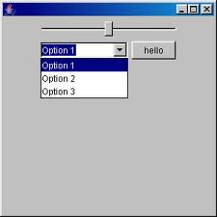
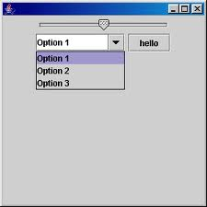
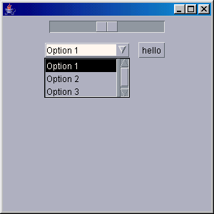
Windows
Metal
Motif
16-<number>

Slide 4
PLAF (cont’d)
Three ways to set look and feel:
  swing.properties file:
  Command-line switch:
  In the program:
swing.defaultlaf=com.sun.java.swing.plaf.windows.WindowsLookAndFeel
C:\> java -Dswing.defaultlaf=java.swing.plaf.windows.WindowsLookAndFeel ...
try {
UIManager.setLookAndFeel("com.sun.java.swing.plaf.windows.WindowsLookAndFeel");
} catch (Exception ex) { … }
16-<number>
Notes:
The default PLAF is “Metal.” A setting in the program overrides the settings in command line (if any) and in the properties file.

Slide 5
GUI Components
Components are created using constructors:
To be usable, a component must be added to the application’s “content pane” or to another component:
JLabel guest = new JLabel ("Guest”);
JPanel scorePanel = new JPanel();
scorePanel.add (guest);
16-<number>
Notes:
Components don’t just “hang there”: each component is linked to its parent component; the top-level component is the application window’s content pane.

Slide 6
Layouts
A layout manager is a strategy for placing components on the content pane or another component (usually a panel).
In Java, the content pane and any GUI component is a Container.
A layout is chosen by calling the container’s setLayout method.
16-<number>
Notes:
Layouts follow the Strategy design pattern mentioned in Chapter 12.

Slide 7
Layouts (cont’d)
Layouts are used to achieve some degree of platform independence and scalability.
awt/Swing support several layout managers. Here we consider four:
  FlowLayout
  GridLayout
  BorderLayout
  BoxLayout
These classes implement the java.awt.LayoutManager interface.
16-<number>
Notes:
There is also a more complicated GridBagLayout.

Slide 8
FlowLayout
Places components in a line as long as they fit, then starts the next line.
Uses “best judgement” in spacing components. Centers by default.
Lets each component assume its natural (preferred) size.
Often used for placing buttons on panels.
16-<number>
Notes:
There is a way to left-justify or right-justify components with respect to the component area by passing an additional parameter to the FlowLayout constructor. For example:
c.setLayout (new FlowLayout(FlowLayout.RIGHT));

Slide 9
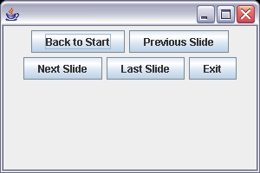
FlowLayout (cont’d)
Container c = getContentPane();
c.setLayout(new FlowLayout());
c.add (new JButton ("Back to Start"));
c.add (new JButton ("Previous Slide"));
c.add (new JButton ("Next Slide"));
c.add (new JButton ("Last Slide"));
c.add (new JButton ("Exit"));
16-<number>
Notes:
FlowLayout is not very precise: it’s hard to control beyond one row.

Slide 10
GridLayout
Splits the panel into a grid with given numbers of rows and columns.
Places components into the grid cells.
Forces the size of each component to occupy the whole cell.
Allows additional spacing between cells.
16-<number>
Notes:
GridLayout is very precise, but each component is stretched or squeezed to fill a grid cell.

Slide 11
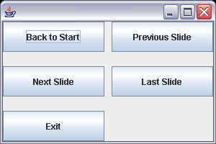
GridLayout (cont’d)
Container c = getContentPane();
c.setLayout (new GridLayout(3, 2, 10, 20 ));
c.add (new JButton ("Back to Start"));
c.add (new JButton ("Previous Slide"));
c.add (new JButton ("Next Slide"));
c.add (new JButton ("Last Slide"));
c.add (new JButton ("Exit"));
Extra space between the cells (in pixels)
16-<number>
Notes:
There is no convenient way to skip a cell: you have to put a dummy component (for example, an empty panel) into it.

Slide 12
BorderLayout
Divides the area into five regions and adds a component to the specified region.
Forces the size of each component to occupy the whole region.
NORTH
WEST
CENTER
EAST
SOUTH
16-<number>
Notes:
The sizes of the regions are adjusted to accommodate components placed into them.

Slide 13
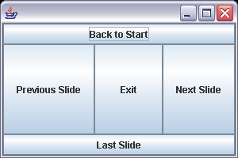
BorderLayout (cont’d)
Container c = getContentPane();
c.setLayout(new BorderLayout()); // optional: default
c.add (new JButton ("Next Slide"), BorderLayout.EAST);
c.add (new JButton ("Previous Slide"), BorderLayout.WEST);
c.add (new JButton ("Back to Start"), BorderLayout.NORTH);
c.add (new JButton ("Last Slide"), BorderLayout.SOUTH);
c.add (new JButton ("Exit"), BorderLayout.CENTER);
16-<number>
Notes:
BorderLayout is actually the default for content pane.

Slide 14
BoxLayout
In a horizontal box, components are placed horizontally, left to right.
In a vertical box, components are placed vertically, top to bottom.
“Horizontal” or “vertical” has nothing to do with the shape of the box itself.
16-<number>
Notes:
A combination of nested horizontal and vertical boxes is often a flexible way to achieve a desired layout.

Slide 15
BoxLayout (cont’d)
BoxLayout is the default layout for a Box container.
The idiom for working with boxes is slightly different:
Box box1 = Box.createHorizontalBox();
box1. add (...);
// add a spacer, 60 pixels:
box1.add(Box.createHorizontalStrut (60));
Box box2 = Box.createVerticalBox();
...
16-<number>
Notes:
There is no particular reason why boxes are handled differently from other Swing components.

Slide 16
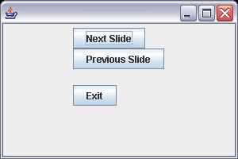
BoxLayout (cont’d)
Container c = getContentPane();
c.setLayout(new FlowLayout());
Box box = Box.createVerticalBox();
box.add (new JButton ("Next Slide"));
box.add (new JButton ("Previous Slide"));
box.add (Box.createVerticalStrut (20) );
box.add (new JButton ("Exit"));
c.add (box);
Adds extra vertical space between components
16-<number>
Notes:
A “vertical strut” in a vertical box (or a “horizontal strut” in a horizontal box) adds extra space between components.

Slide 17
Default Layouts
Each component has a default layout manager, which remains in effect until the component’s setLayout method is called.
The defaults are:
  JFrame BorderLayout
  JPanel FlowLayout
  Box BoxLayout
16-<number>
Notes:
Content pane is a Container returned by JFrame’s getContentPane method.

Slide 18
Menus
You can add a JMenuBar object to JFrame or JApplet.
You can add JMenu objects to a JMenuBar.
You can add other JMenus, JMenuItems, JCheckBoxMenuItems, JRadioButtonMenuItems, etc. to a JMenu.
16-<number>
Notes:
Writing code for menus manually is rather tedious. GUI authoring tools help automate this process.

